Slide 1

OLIVINE for CO₂ capture and safe storage
Domenica Minervini

Slide 2
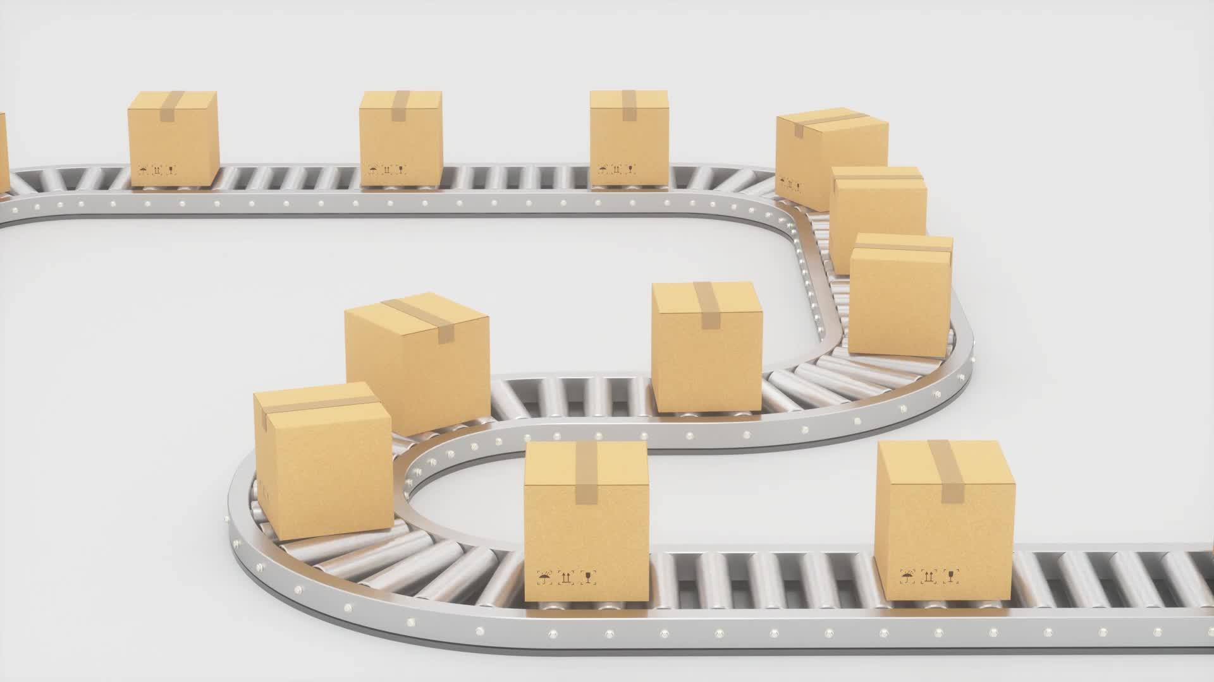
PROSPECTS FOR CO₂ UTILIZATION AND REMOVAL

Slide 3
Prospects for CO₂ utilization and removal
Several methods have been proposed in recent years to counteract climate change, pollution and ocean acidification by removing CO₂ from the atmosphere.
CO₂ sequestration from the atmosphere is being considered as a method to reduce its greenhouse effect and to lower the Earth’s surface temperature.
The capture and use of carbon dioxide to create valuable products has been receiving interest from the scientific community for two reasons.
1) Climate change considerations.
2) CO₂ usage in industrial or chemical processes can be cheaper or cleaner compared with using conventional hydrocarbons.

Slide 4
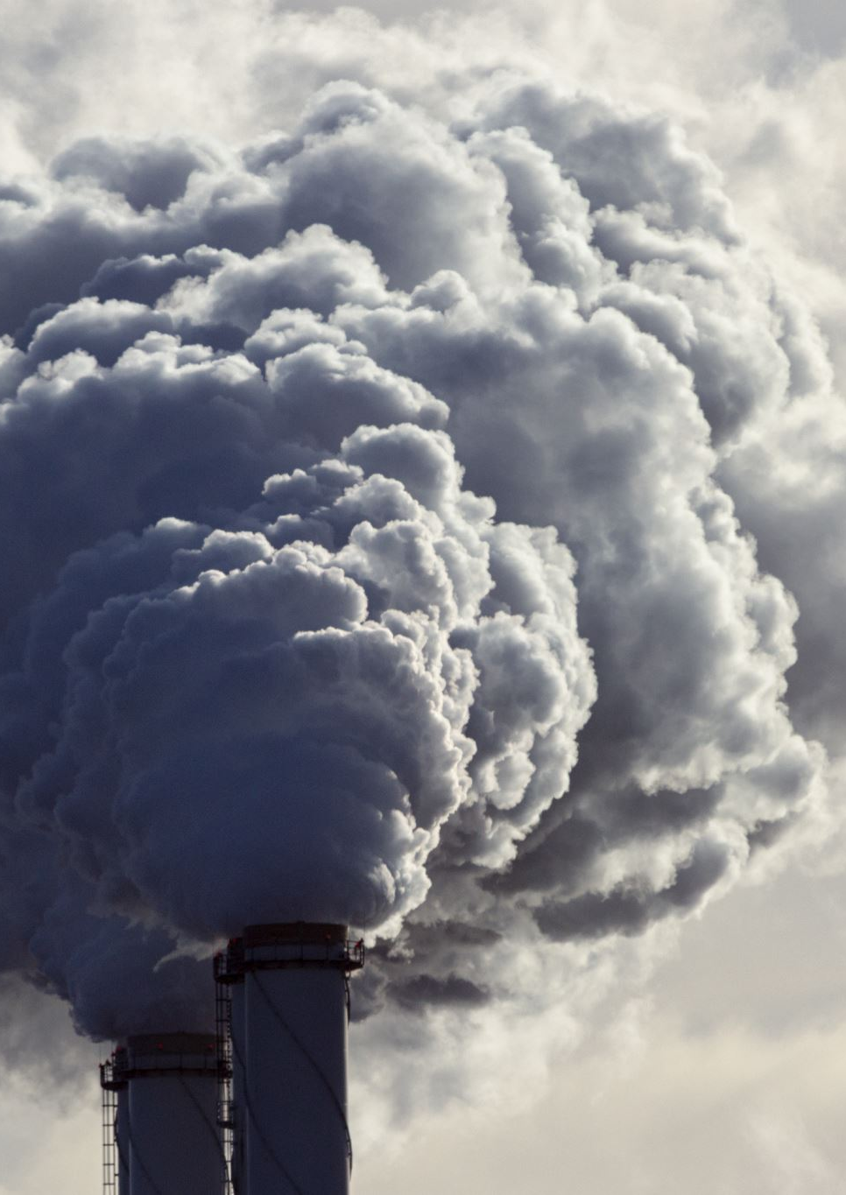
Prospects for CO₂ utilization and removal
It is called Carbon Dioxide Capture and Storage, CCS, the process with which CO₂ is:
captured from air,
stored industrially (materials) or biologically (trees),
reused.
CO₂ is supplied from fossil-derived waste gases and then is captured from the atmosphere by industrial processes or by land-based processes.
These methods have been promoted to remove carbon dioxide from the atmosphere.

Slide 5
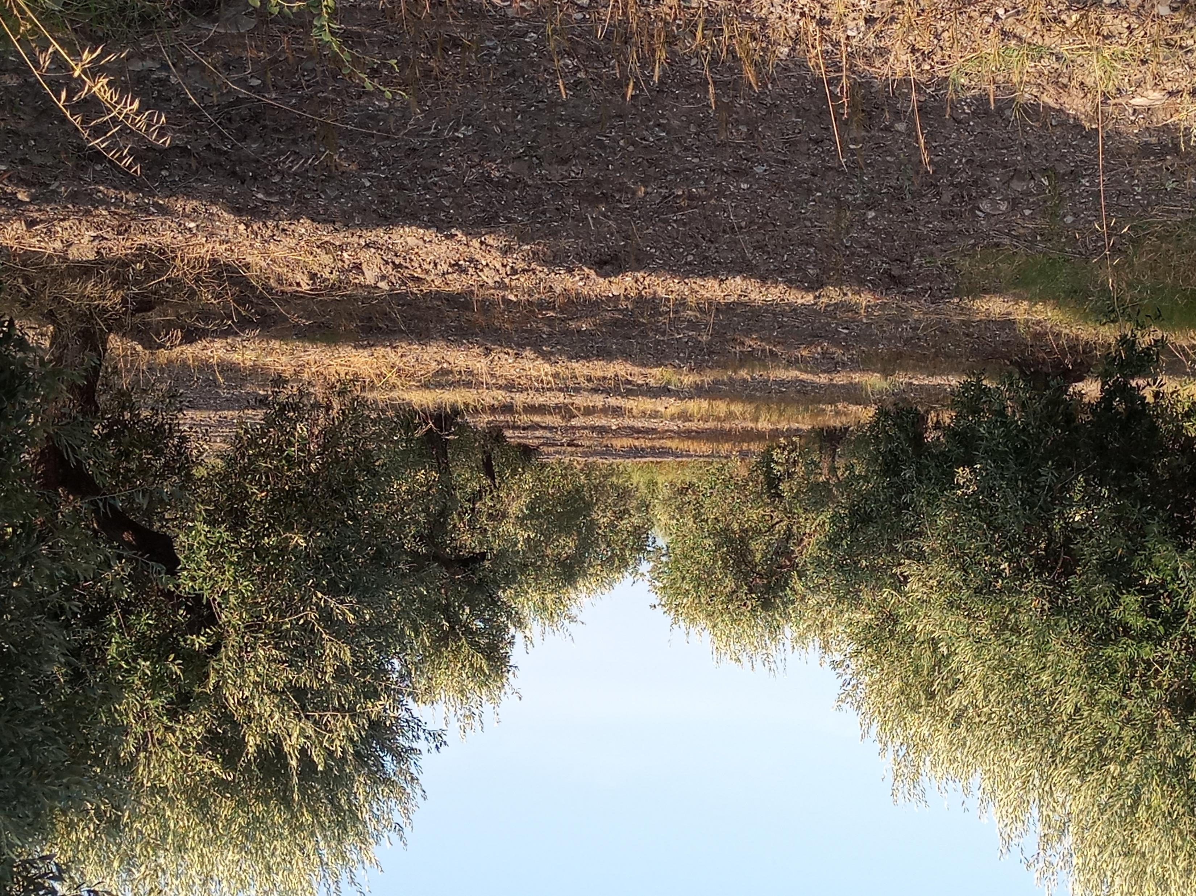
Prospects for CO₂ utilization and removal
CO₂ utilization in industrial or chemical processes gives valuable-carbon containing products.
Biological land-based processes can generate economic value in the form of, for example, wood products for buildings or by increasing plant yields from enhanced soil carbon uptake.

Slide 6
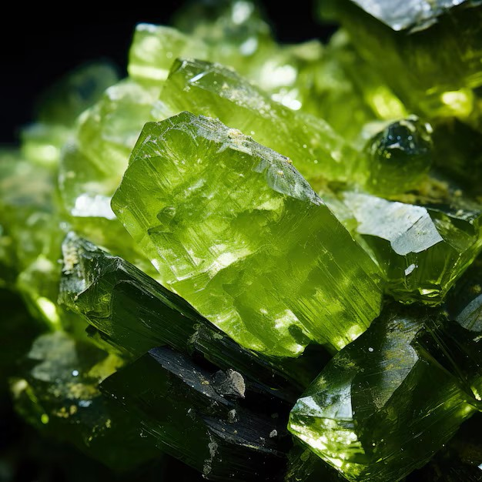
Prospects for CO₂ utilization and removal
CCS has the disadvantage that it is expensive to perform, although it brings to economic achievements.
There are alternative methods to capture CO₂ , provided by nature and less expensive.
A promising approach is the storage of CO₂ in minerals, of which mineral Olivine is a good candidate.

Slide 7
OLIVINE FOR ATMOSPHERIC CO₂ CAPTURE

Slide 8
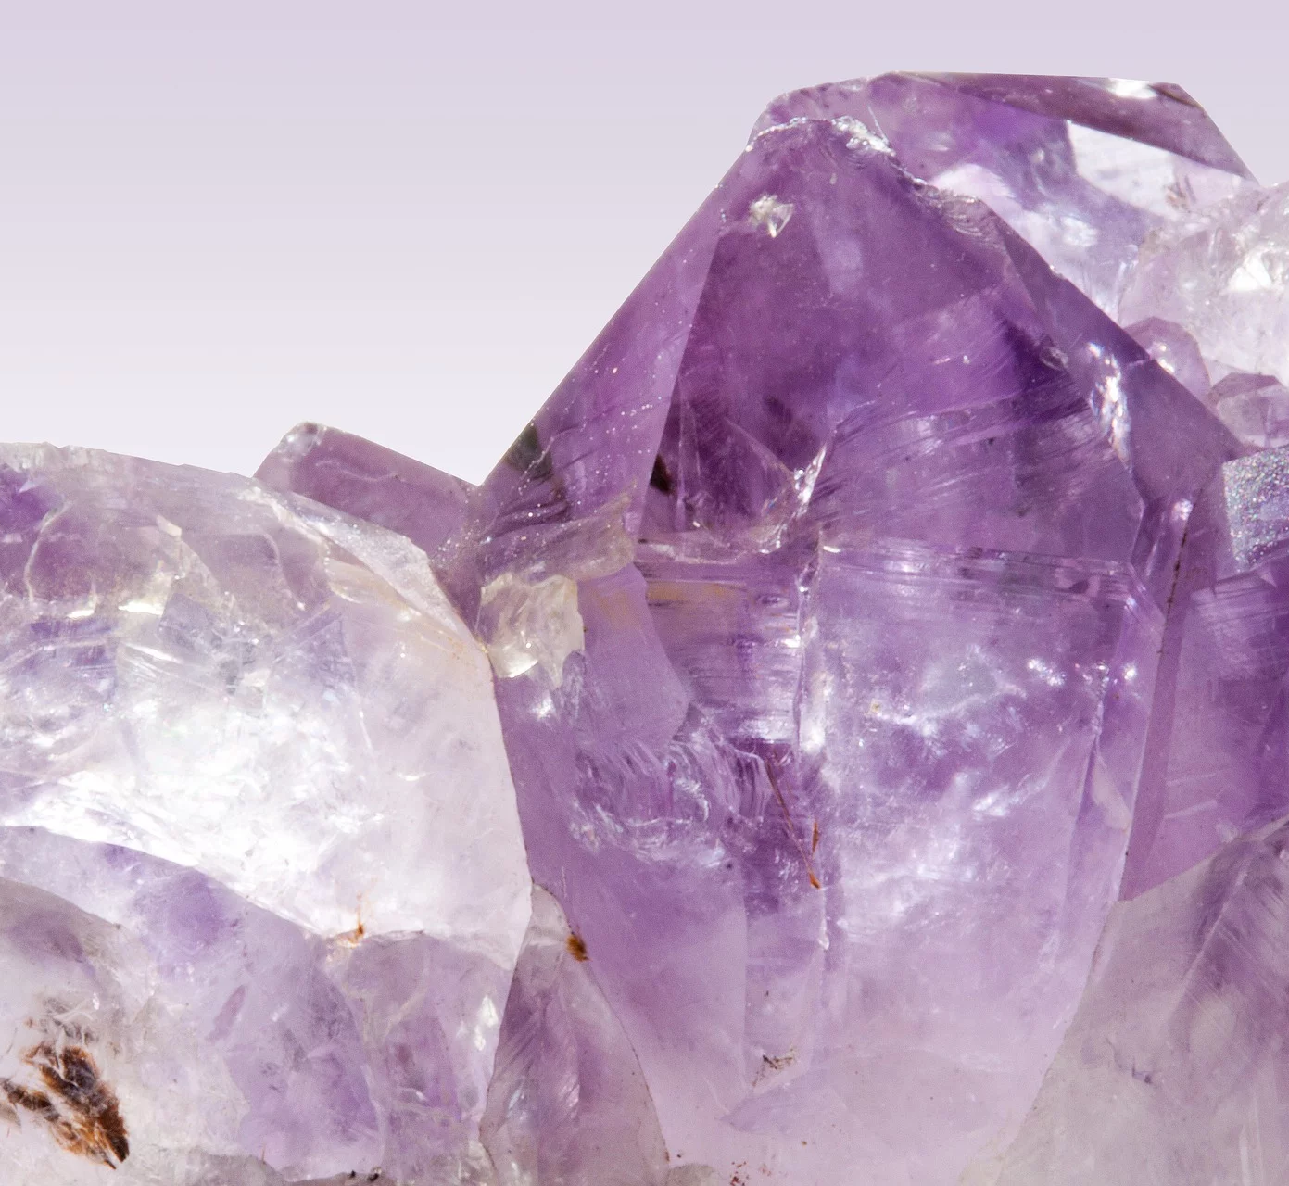
Olivine for atmospheric CO₂ capture
It is called Carbon Dioxide Removal, CDR, a process with which CO₂ is removed from the atmosphere.
It can be achieved by different techniques or device, for example by storing CO₂ in minerals.
In geology, a mineral is a naturally occurring solid that has a well-defined chemical composition and a crystal structure.

Slide 9
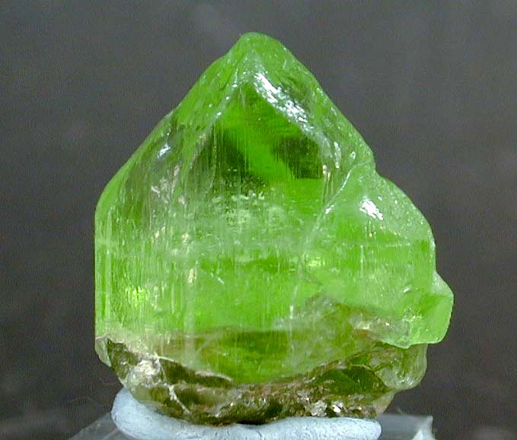
Olivine for atmospheric CO₂ capture
The mineral Olivine is a magnesium iron silicate with chemical formula: (Mg,Fe)₂SiO₄ .
Olivine is a promising candidate for the storage of CO₂ in minerals because of its Earth abundance and its high CO₂ absorption capacity, which is of the order of 50 wt. %.

Slide 10
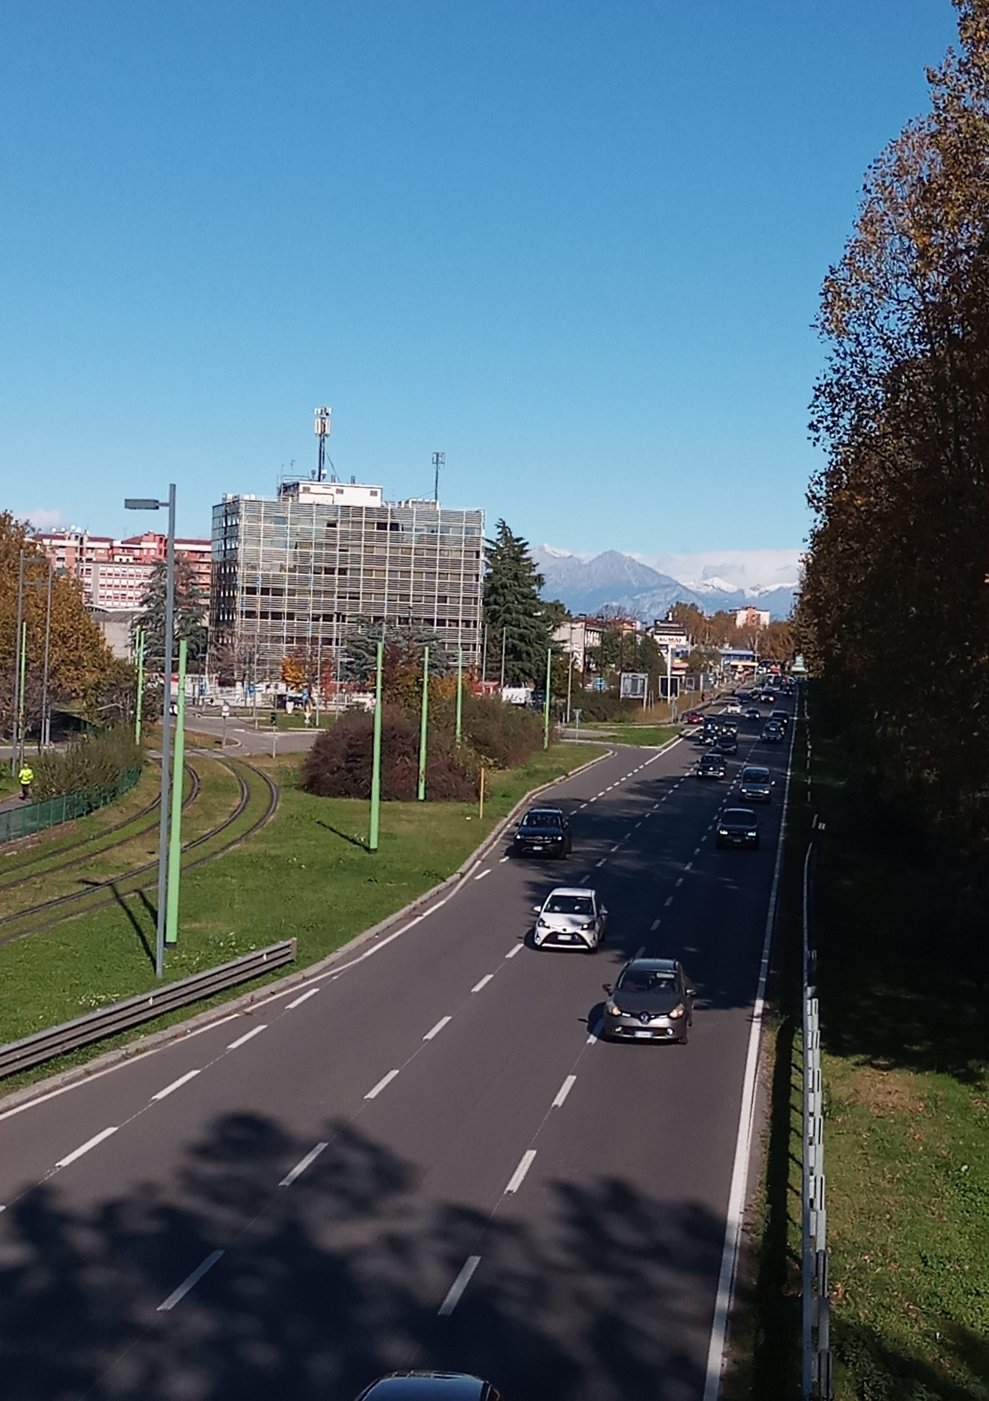
Olivine for atmospheric CO₂ capture
Each year the Earth emits 0.5 Gt of CO₂ , mainly by volcanoes. To it add CO₂ emitted by industries and cars.
But atmosphere isn’t dominated by CO₂ because there is a combination of processes by which CO₂ is removed and safely stored.
This processes has been keeping the CO₂ levels of the atmosphere in check during the history of the Earth.

Slide 11
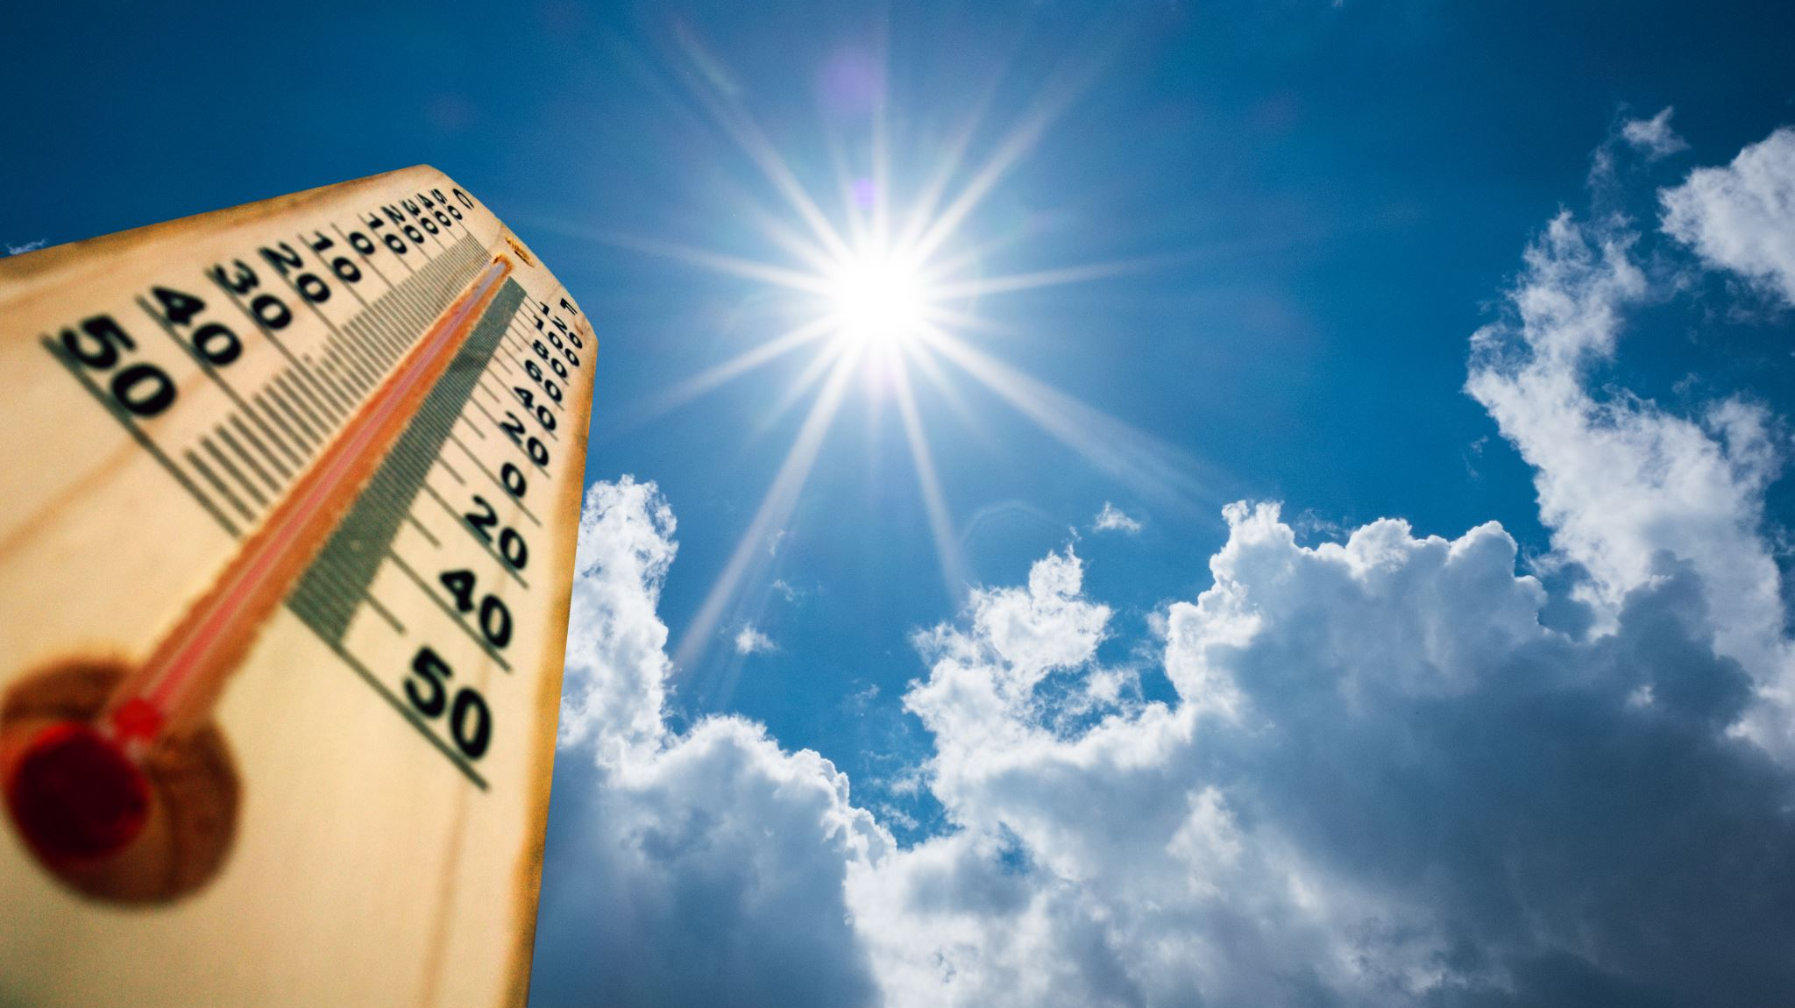
PROCESSES FOR CO₂ CAPTURE: WEATHERING AND CARBONATION

Slide 12
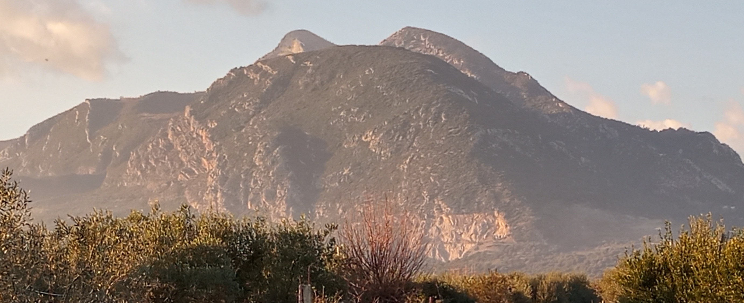
Weathering process
Weathering is the process by which rocks, soil and minerals are broken down at the Earth’s surface due to physical, chemical or biological agents.
Once the rock or mineral falls on the Earth’s surface, it can interact with the fluid, either the atmosphere or the ocean, that brings the CO₂.

Slide 13
Mineral carbonation
Mineral carbonation is the reaction of silicate or oxide minerals with CO₂ in fluids, to form solid carbonate minerals.
Mineral carbonation has been proposed as a method for safe and permanent CO₂ storage.
In mineral carbonation gas CO₂ is converted to stable, solid, carbonate minerals.
Carbonation of olivine often occurs together with hydration, a process involving the addition of water.
Mg-olivine reacts with CO₂ (carbonation) and with H₂O (hydration) via more possible reactions.
The product is always magnesite, a magnesium carbonate mineral, with chemical formula MgCO₃.
Olivine is the most abundant mineral on the Earth: this is why is used for mineral carbonation.

Slide 14
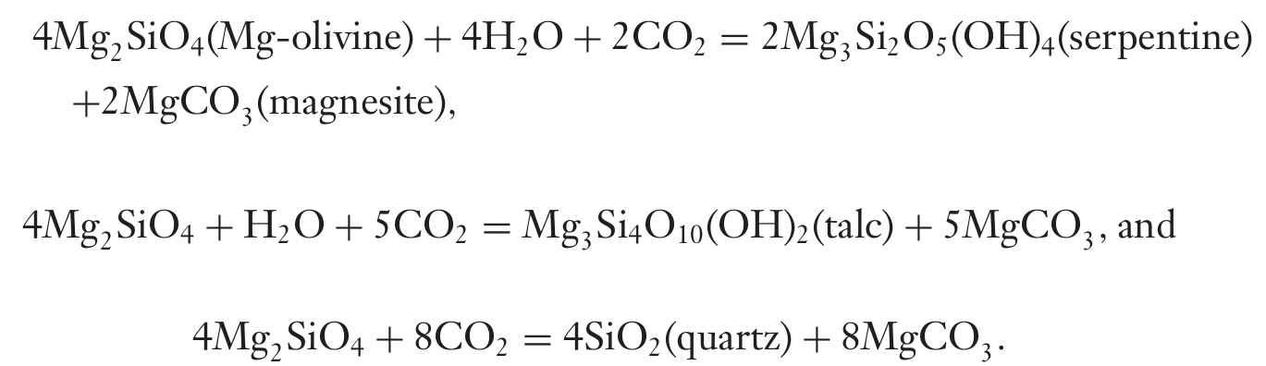
Mineral carbonation

Slide 15
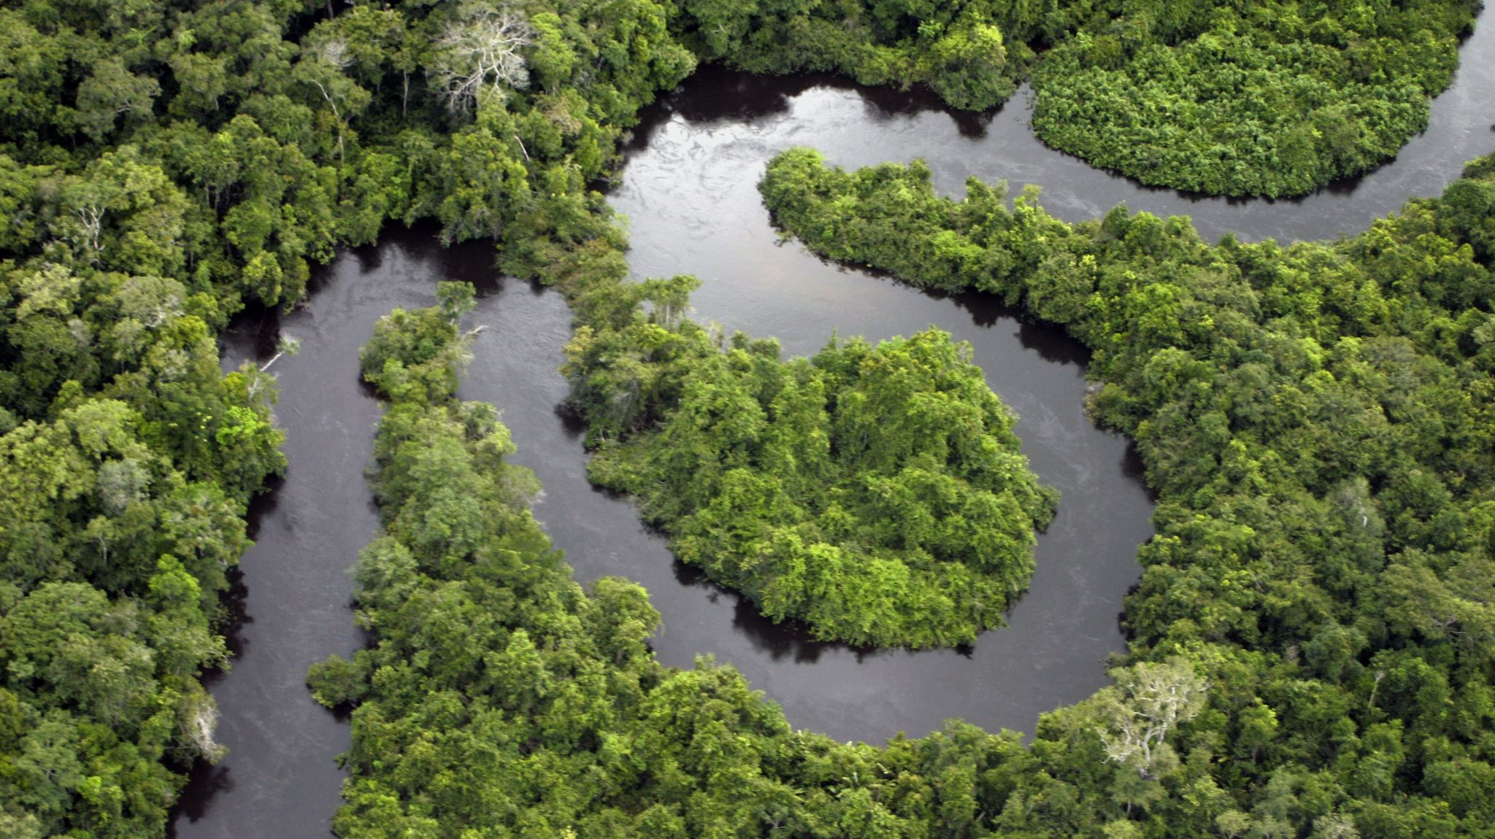
IN SITU PERIDOTITE CARBONATION

Slide 16
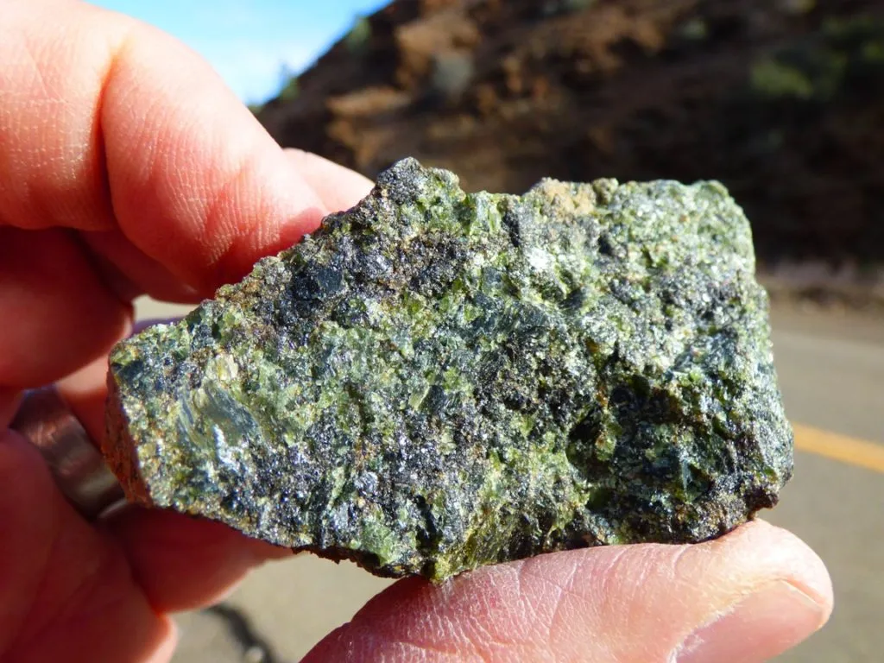
In situ peridotite carbonation
How do Mg-olivine and CO₂ meet?
Peridotite is a rock composed of more than 40% olivine.
In situ peridotite carbonation is a process in which CO₂-rich fluid (air or seawater) is transported to areas where large volumes of peridotite are present.
Mg-olivine interacts with the fluid by its surface. Then the chemical reaction of mineral carbonation takes place.
An area with a large amount of peridotite is the Samail ophiolite in Oman.
Ophiolite is an uplifted slice of oceanic crust and upper mantle.

Slide 17
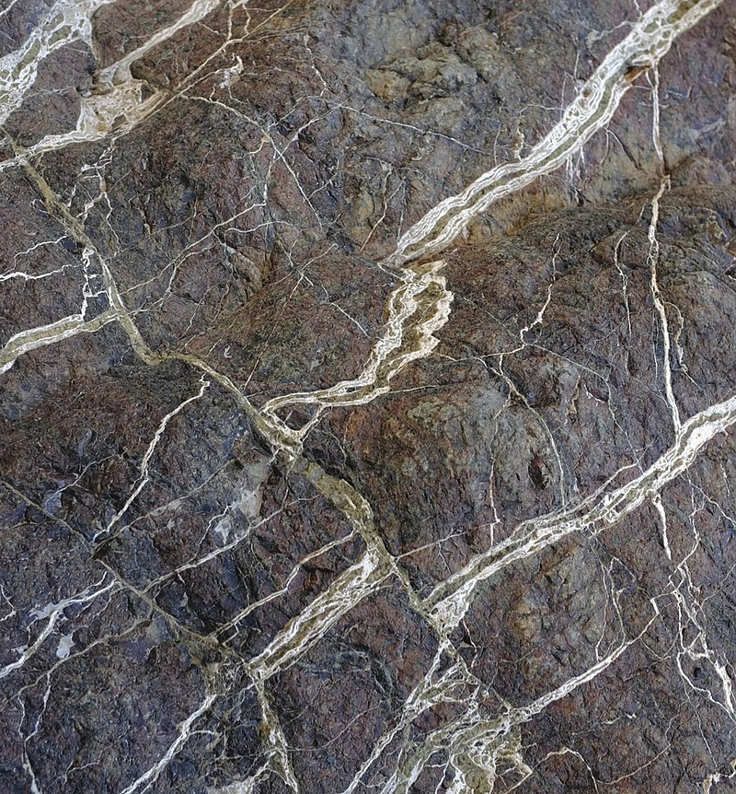
In situ peridotite carbonation
Natural carbonation of peridotite in the Samail ophiolite, in the Sultanate of Oman, is relatively rapid.
As a consequence, in veins in mantle, peridotite can convert a huge quantity of CO₂ by weathering and carbonation.
Data show that 10⁴ – 10⁵ tons of CO₂ per year are converted to solid carbonate minerals.
This process can be accelerated via drilling peridotite, making larger the contact surface between the rock and the fluid.

Slide 18
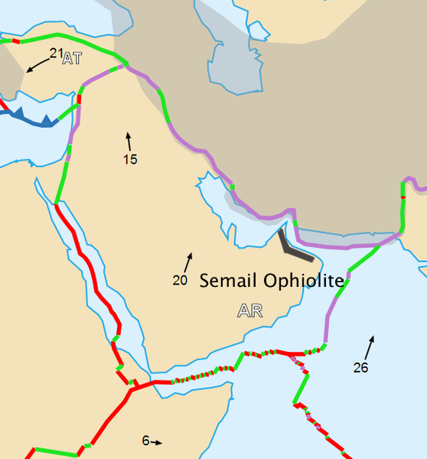
In situ peridotite carbonation
Natural peridotite carbonation has two limitations.
It is a very long process: in Semail Ophiolite in Oman it has the exceptional lasting of 26.000 years. In the rest of the world, it takes millions of years.
To remove CO₂ from the entire atmosphere, the process of carbonation should take place all over the world, not only in certain regions.
To make peridotite carbonation faster and wider, mineral olivine rocks should be fragmented in nanoparticles.

Slide 19
NANOSCALE OLIVINE FOR ATMOSPHERIC CO₂ CAPTURE

Slide 20
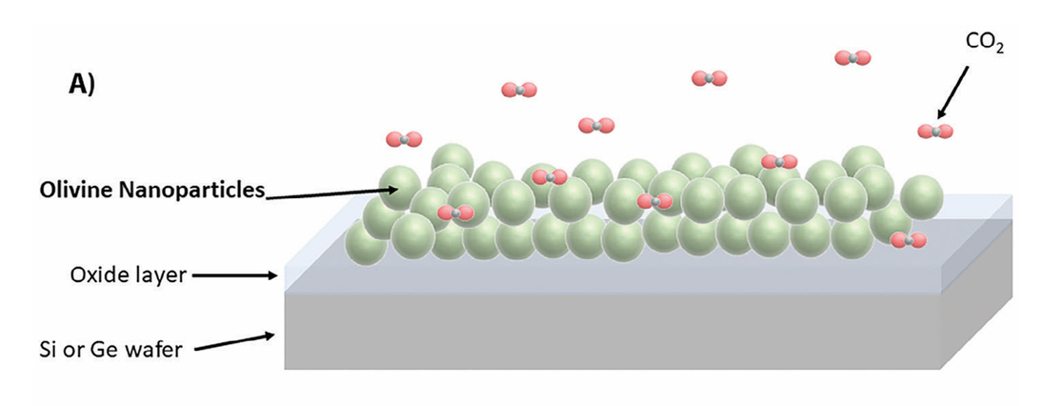
Nanoscale olivine for atmospheric CO₂ capture
To accelerate the reaction rate of peridotite rock carbonation at ambient conditions, CO₂ is supplied at extreme pressures and temperature.
Nanoscale olivine particles, due to their high surface-to-volume ratio, reach a very high rate of carbonation at a time scale of minutes at ambient conditions.

Slide 21
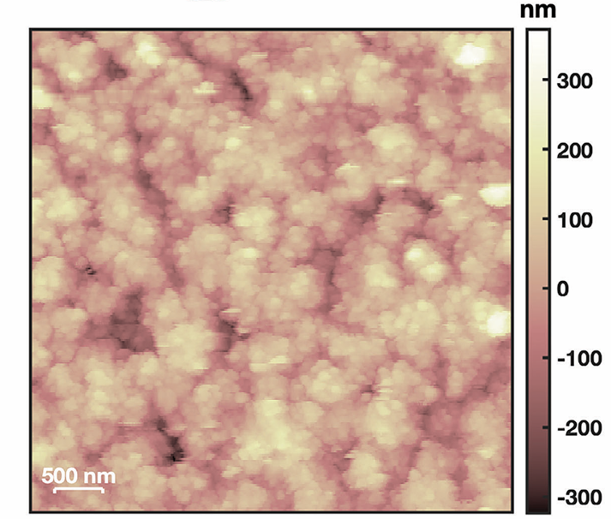
Nanoscale olivine for atmospheric CO₂ capture
The morphology of the nanoparticles was investigated by Atomic Force Microscope, and showed fractal cauliflower structure:
smaller nanoparticles with a size of 14 nm aggregate to form
larger cauliflower nanoparticles, with a size of 150 nm.

Slide 22

CONCLUSION AND PERSPECTIVE

Slide 23
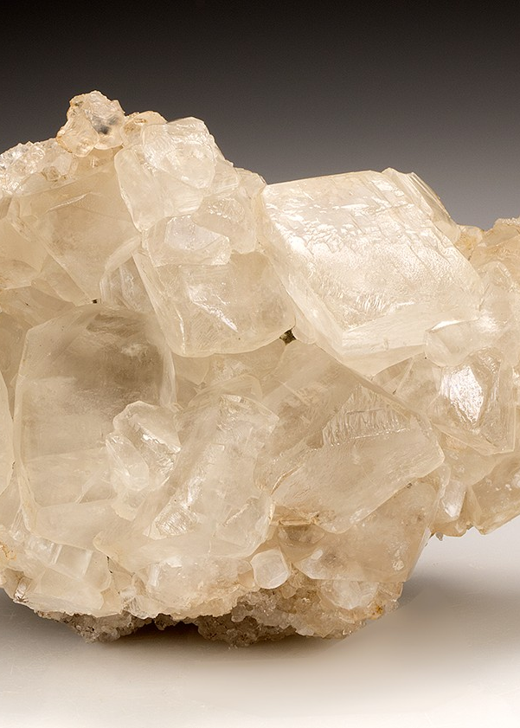
Conclusion and perspective
Several methods to counteract climate change have been investigated.
A promising method is Carbon Dioxide Removal, CDR, performed with minerals.
Olivine (Mg₂SiO₄) is a good candidate to perform CDR because of its high CO₂ absorbance.
Mineral carbonation is the process with which gas CO₂ is converted to a solid, stable mineral.
Olivine reacts with CO₂ then they are transformed in magnesite (MgCO₃) plus another mineral.
Limitation: mineral carbonation is a slow process and not expanded all over the world.
Idea to make olivine nanoparticles. Reaction faster due to their high surface-to-volume ratio.
By fractioning olivine in nanoparticles is possible to make an enhanced weathering process.

Slide 24
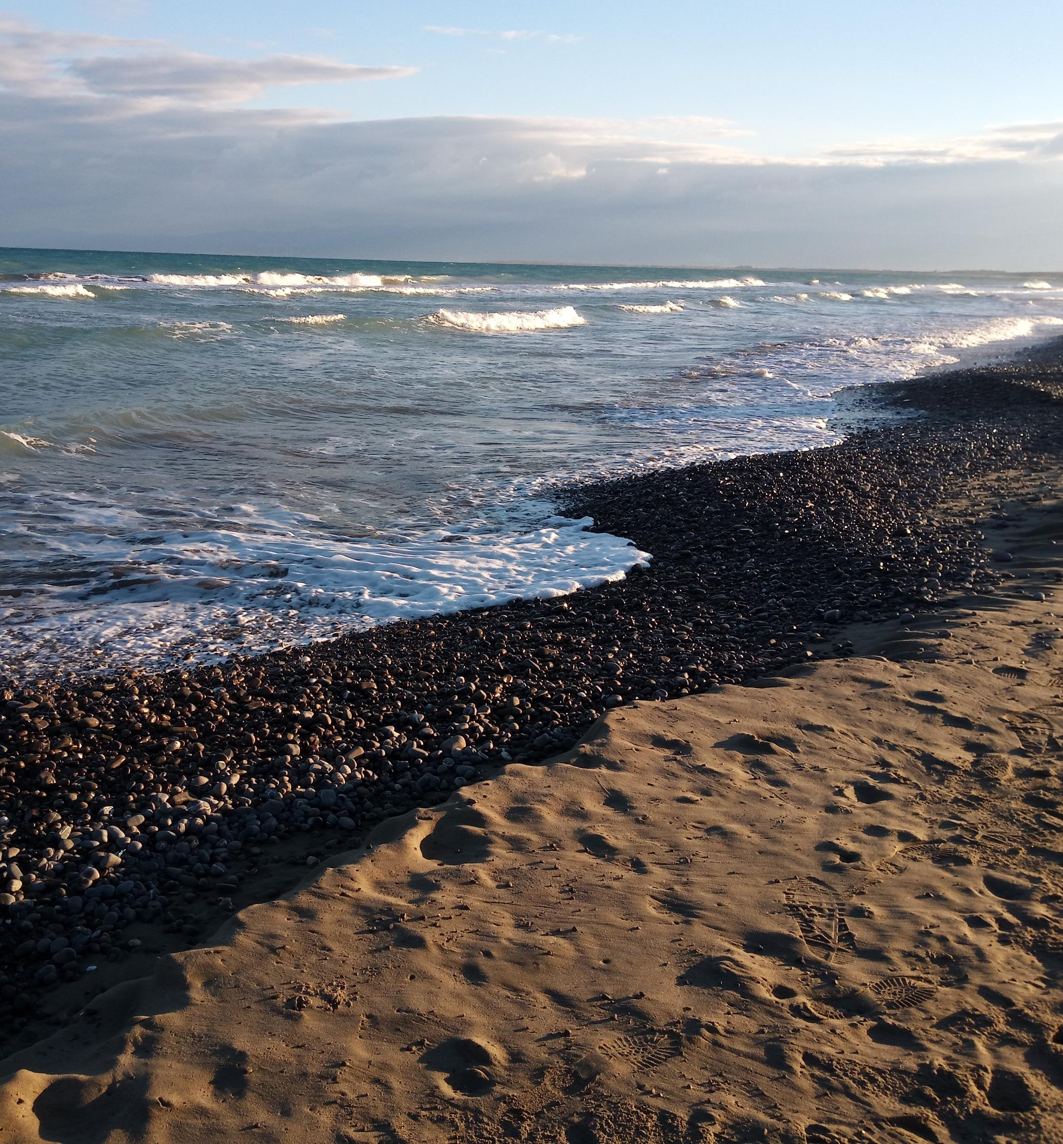
Conclusion and perspective
It is possible to enhance the weathering process as follows:
mine olivine in various location, strategically distributed over the globe,
mill olivine to make from it a powder, made by olivine nanoparticles,
spread fine-grained olivine powder over agricultural and forest land or along beaches.
Removing CO₂ from the atmosphere and storing it safely can be possible.

Slide 25
THANK YOU

